Slide 1
Results of A Compact Reflex Triode With Multi Cavity Adjustment
D. Barnett, K. Rainwater, J. C. Dickens, A. Neuber, J. Mankowski
Center for Pulsed Power and Power Electronics (P³E)
Department of Electrical Engineering
Texas Tech University
Box 43102, Lubbock, TX 79409-3102, USA
2017 Pulsed Power Conference
June 18th – 22th, Brighton, UK

Slide 2
Overview
Background and Motivation
  Cathode
  Anode
  Tube Structure
Experimental Setup
  Sealed Tube Reflex-Triode Vircator
  Pulsed Power Source
Experimental Results
  Frequency tunability comparison
Future Work
Notes:
Quickly skim through this

Slide 3
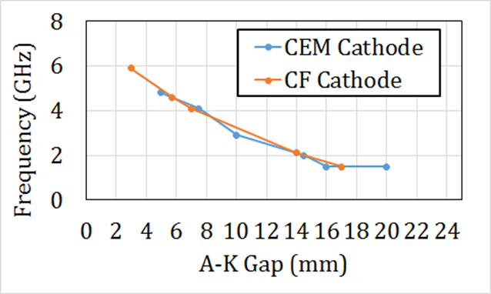
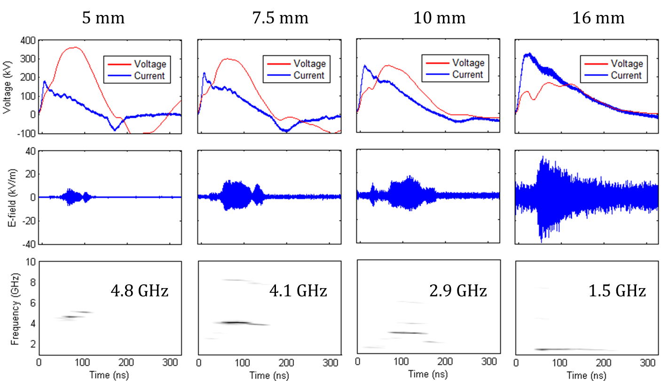
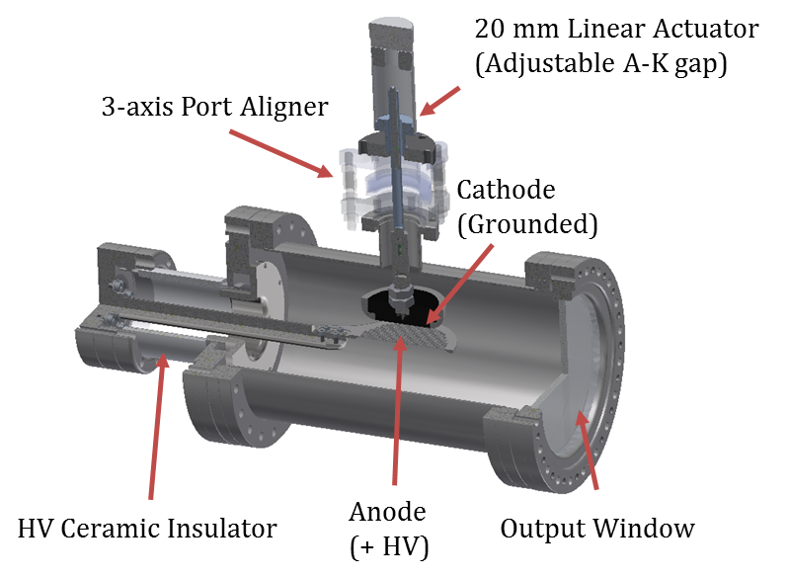
Old Tube Performance
Only a few main frequencies
Low power at a large majority
Limited ability to adjust performance

Slide 4
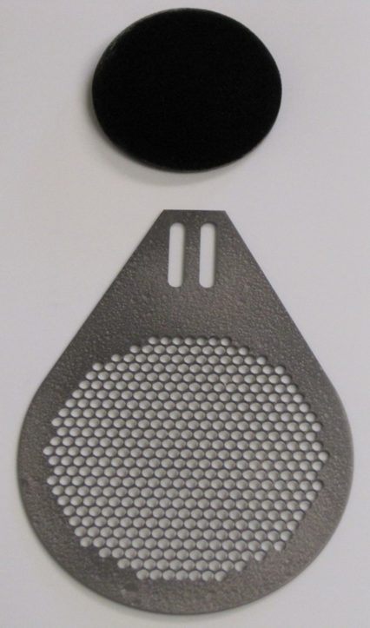
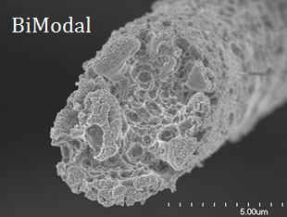
Cathode and Anode
SEM imaged eroded CF tip
Bimodal carbon-fiber (CF) cathode
2 million CF pyrolitically bonded to a POCO graphite substrate
Rogowski-profile
2.5” diameter
Pyrolitic graphite anode
Long life time >100,000 shots
High thermal emissivity
70% transparent
3.5” diameter
Electron source → Explosive emission induce plasma

Slide 5
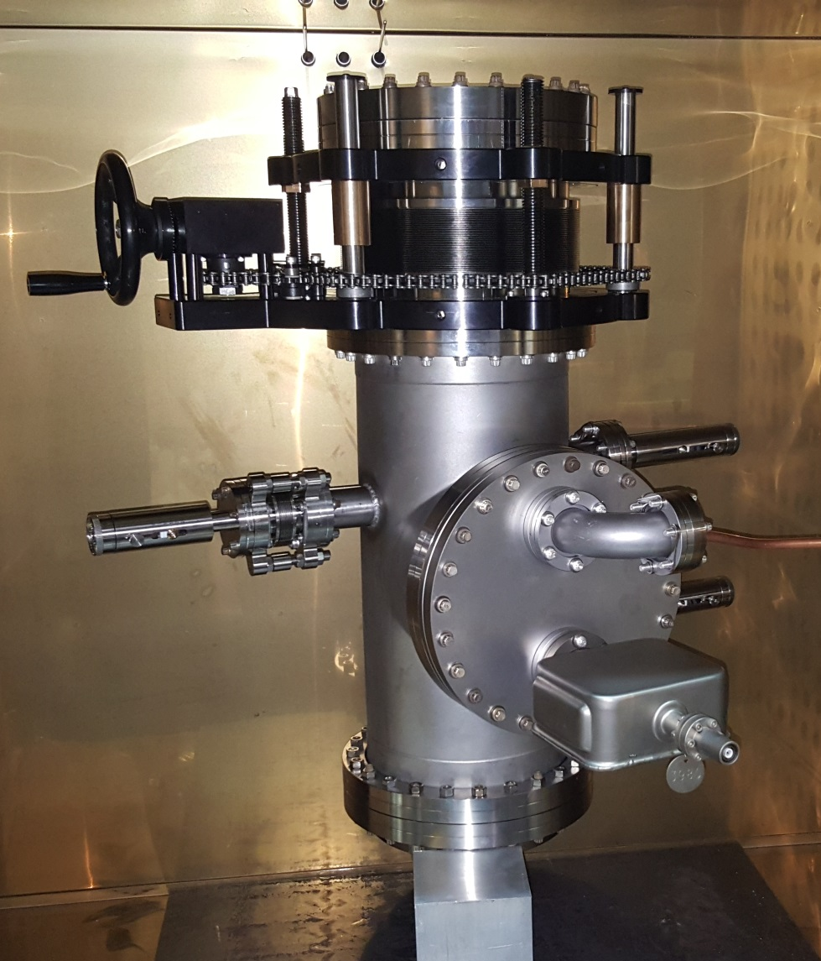
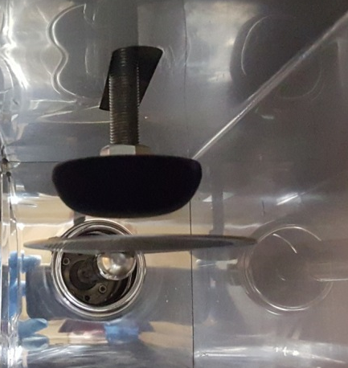
Cathode Conditioning
Tube Preparation
  Extreme cleaning of internal components
  Plasma cleaning of smaller components
  Bake out at 175℃ for 72 hours while connected to a turbo molecular pump
Procedure
  >1,000 shots minimum
  Shots taken at 10Hz, 20 shot burst
  50 kV charging voltage
  8 mm A-K gap

Slide 6
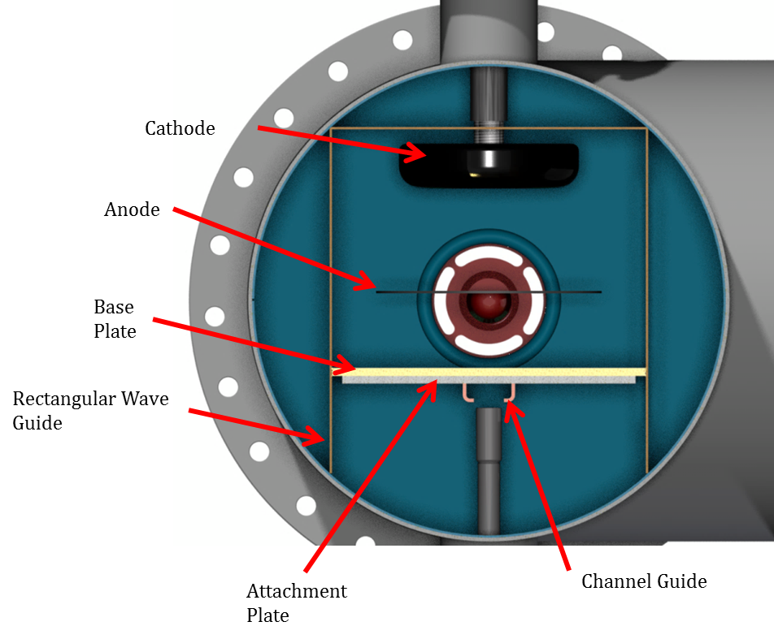
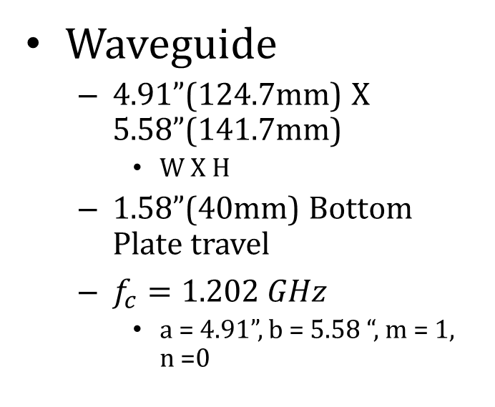
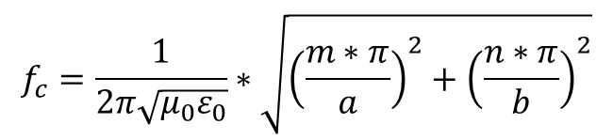
Square Waveguide Structure
Waveguide
  4.91”(124.7mm) X 5.58”(141.7mm)
    W X H
  1.58”(40mm) Bottom Plate travel
  $f_{c}=1.202 GHz$
    a = 4.91”, b = 5.58 “, m = 1, n =0
$$f_{c}=\frac{1}{2π\sqrt{μ_{0}ε_{0}}}∗\sqrt{{\left(\frac{m∗π}{a}\right)}^{2}+{\left(\frac{n∗π}{b}\right)}^{2}}$$

Slide 7
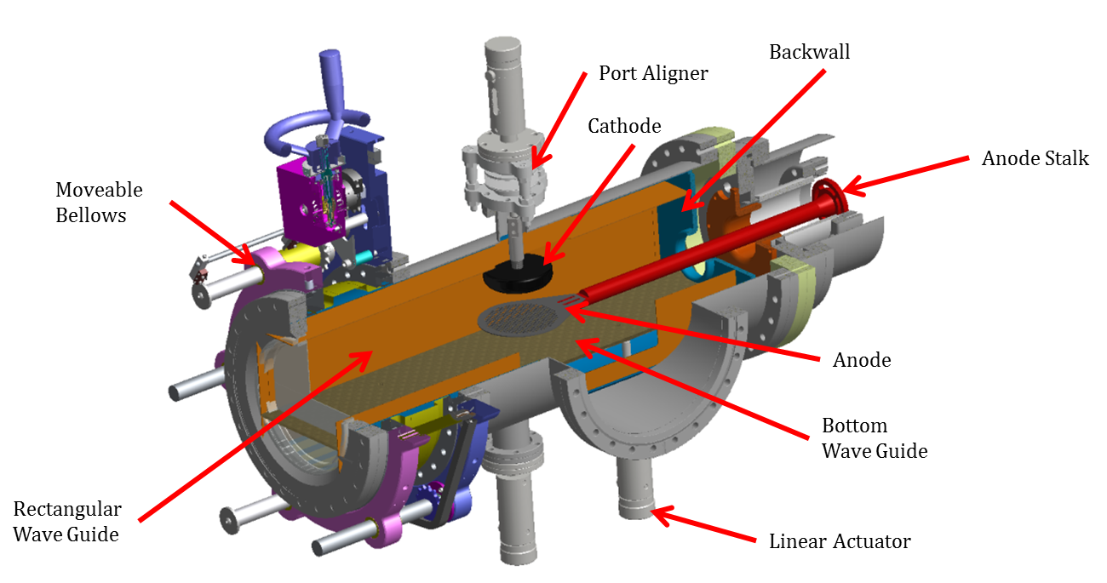
Sealed Tube Reflex-Triode Vircator
Tube characteristics
Background pressure: ≈ 10⁻⁹ Torr
  Backed by a 20 L/s ion pump
8” Tube
Internal liner
Movable Backwall (BW)
Movable Bottom Plate(BP)
Adjustable Anode –Cathode Gap (AK gap)
Sealed tube
Diagnostics
Capacitive Voltage Divider
Person Current Monitor
Wide Band Receiving Antenna

Slide 8
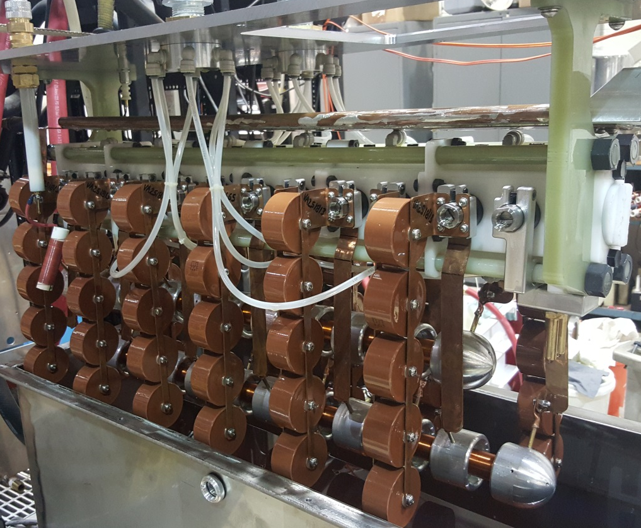
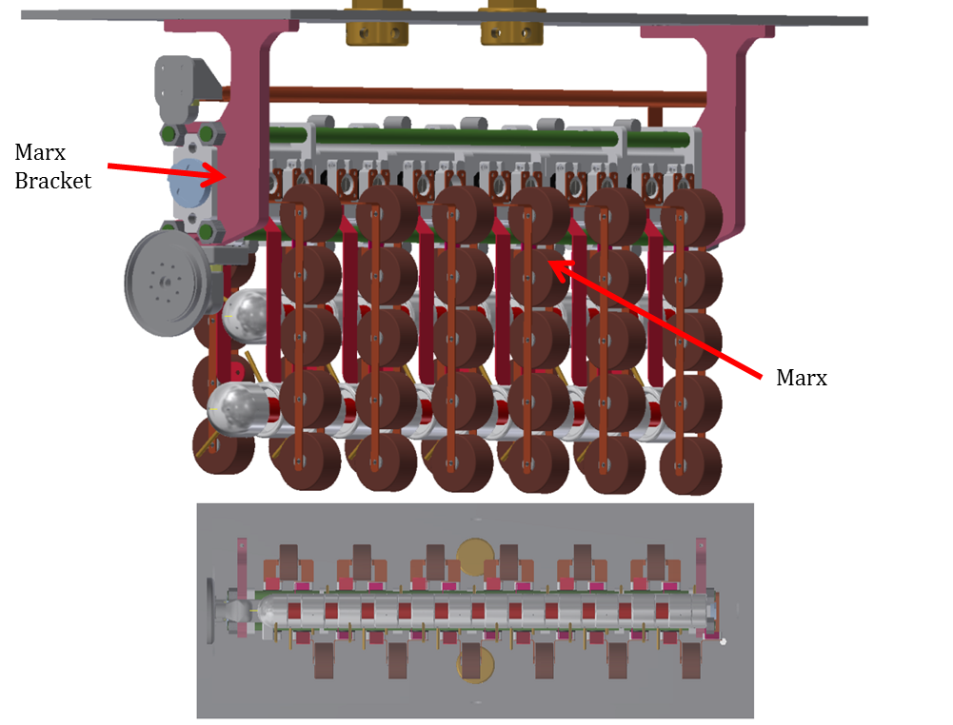
Pulsed Power Source
12 stage PFN-based Marx Generator
  Rayleigh PFN
  50 kV charging voltage
  600 kV output @ 50 kV charge (open circuit )
  ≈65 Ω output impedance
  100 ns FWHM
  157 J

Slide 9
Experimental Results
Result settings
  Backwall : 0mm – 17.5mm in 2.5mm steps
  Bottom plate : 0mm – 32mm in 2mm steps
  AK sweep : 5mm – 24.5mm in .5mm steps
Notes:
Quickly skim through this

Slide 10

E-Field Vs. Frequency @ 3m
Notes:
Red arrows shows old tube frequencies
Blue shows microwave patterns in future slides

Slide 11
Frequency Vs. AK, E-Field > 25KV
Notes:
Shows the frequency steps for different AK settings while showing the different BW settings

Slide 12
Settings Showing Frequency Movement

Slide 13
Settings Showing Frequency Movement

Slide 14
2GHz Shot Summary
Total estimated radiated power ≈139MW
Estimated efficiency ≈ 13.4%
  Calculated from Marx Energy & pulse width
  RF was considered rotationally symmetric across beam spot

Slide 15
5.36GHz Shot Summary
Total estimated radiated power ≈ 77MW
Estimated efficiency ≈ 7.5%
  Calculated from Marx Energy & pulse width
  RF was considered RF was considered rotationally symmetric across beam spot

Slide 16
5.36GHz Mode Pattern

Slide 17
2GHz Mode Pattern
Notes:
Slide is hidden from the audience

Slide 18
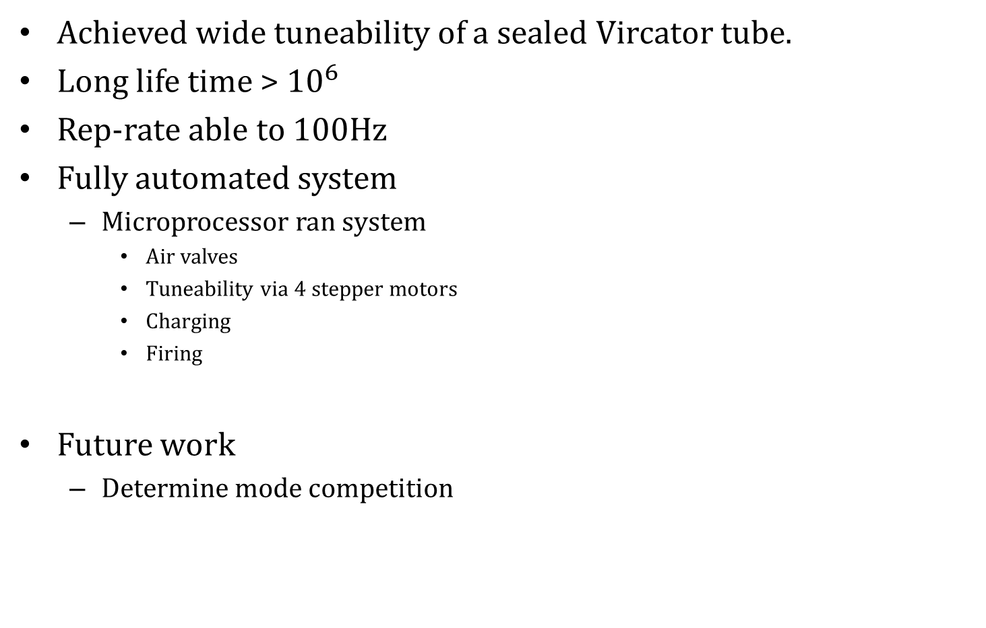
Summary
Achieved wide tuneability of a sealed Vircator tube.
Long life time > ${10}^{6}$
Rep-rate able to 100Hz
Fully automated system
  Microprocessor ran system
    Air valves
    Tuneability via 4 stepper motors
    Charging
    Firing
Future work
  Determine mode competition

