Slide 1
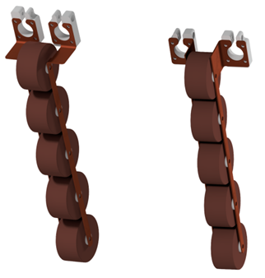
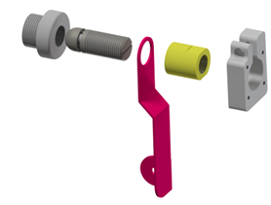
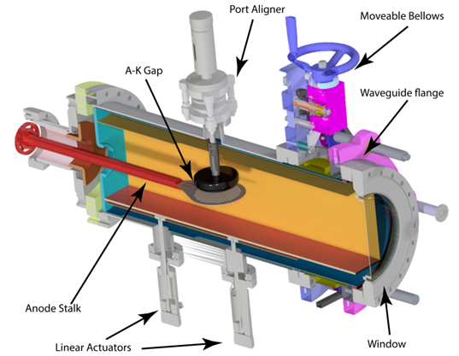
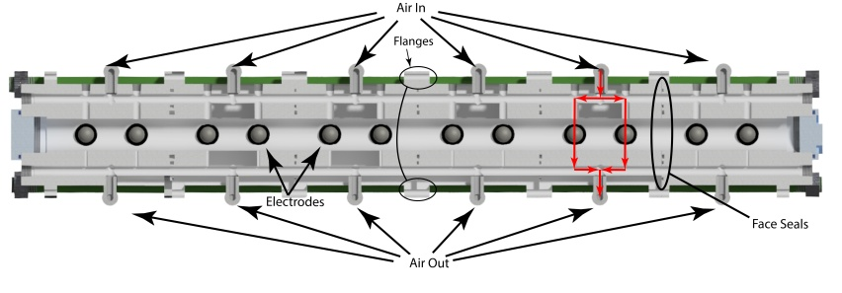
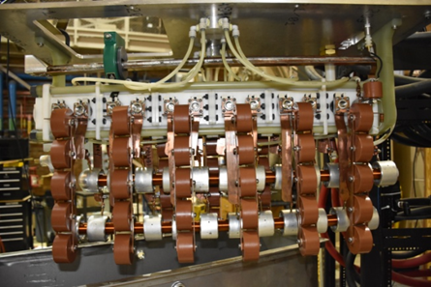
160 J, 100 HZ REPETITION RATE, COMPACT MARX GENERATOR AND HIGH POWER MICROWAVE SYSTEM
IN USE AT TEXAS TECH UNIVERSITY
K. Rainwater, *D.H. Barnett, J. C. Dickens, A. Neuber and J. J. Mankowski
Center for Pulsed Power and Power Electronics, Department and Electrical and Computer Engineering, Texas Tech University, Lubbock, TX
Pulsed Power Conference, June 18-22, 2017, Brighton, UK
Abstract
Marx Generator Design
This paper presents the electrical and mechanical hardware considerations of a compact, 160 J modular pulse forming network (PFN) Marx generator used to drive a high-power microwave (HPM) source that is a time variant load at a PRF of 100 Hz. The modular Marx generator is designed to produce an open-circuit output voltage of 600 kV from a 50 kV source using twelve stages. Each stage of the Marx was constructed from a PFN created with five, 2.1 nF, high voltage capacitors in parallel. Each Marx module was machined out of acetyl copolymer or Delrin© to provide optimal strength, rigidity, and a dielectric constant that closely matches transformer oil. These Marx modules include air supply lines that are machined directly into each block of Delrin© allowing airlines to connect to each module chamber rather than every spark gap. Each module has two electrode inserts placed into the sealed pressure vessel contained within the module.
After the Marx erects the energy is directed into the Virtual Cathode Oscillator where subsequent frequency generation is manipulated through a rectangular waveguide contained within a new resonator cavity design. The new design allows the bottom wall, back wall, and anode cathode gap to be moved by two linear actuators, a linear bellows, and another linear actuator, respectively. The cavity is contained within a 10-inch circular vacuum chamber with a round stainless steel sleeve running from the back wall to the linear bellows. Contained within the round sleeve is a rectangular waveguide where the bottom wall and the cathode are housed. The anode is connected to the Marx generator via a nickel shaft that feeds through the back wall into the circular sleeve and into the rectangular waveguide. The anode made from pyrolytic graphite, remains stationary while the bottom wall, and carbon fiber velvet cathode move relative to its position. The benefit of this design is the height and depth of the cavity resonator can be controlled independently of each other while still allowing the A-K gap to be manipulated on its own.
A.
The PFNs are attached to the electrodes through an insert-electrode-sleeve-clamp design shown in Figure 2B. The sleeve allows the PFNs to be attached without preventing the electrodes from turning, allowing the spark gap distance to be adjusted without removing the PFNs. This is important because the first spark gap is trigged and set for the lowest self-break voltage; tapering to the final peaking gap set to two and half times that of the first gap. The Marx PFNs made up of 2.1 nF capacitors shown in Figure 2A attach to the electrode sleeve through clamps shown in Figure 2A. The copper brackets were designed to provide 35 nH of inductance between each capacitor making for a total of 70 nH per stage of the PFN.
B.
Also connecting to the electrode assembly the charging inductors, shown in Figure 2C, hang underneath the Marx supported by copper brackets, shown in Figure 2A. The inductors provide 4.35 mH of inductance between each stage of the Marx generator and allow for rapid charging but an impedance of 230 kΩ during discharge. Each inductor is constructed with a modular design that breaks the coils into 2” segments. Quad-polyimide magnet wire was wound from one center ring, around a 1” Delrin© rod and terminated at another, forming one segment of the inductor. After the coils are wound, outer shield rings are slid onto each center ring and tightened down using set screws. This is to bring the high field away from the inductor edge, reducing premature failure of the charging inductors.
C.
Marx Generator Tube Design
Fig. 2: A. PFN capacitor arrangement, B. Electrode sleeve Design, C. Charging inductor shown with field shaping rings.
The Marx shown in Figure 1 is constructed from six acetyl copolymer (Delrin©) modules. Delrin© was chosen as a primary build material to balance cost, machinability, and having a dielectric constant close to that of transformer oil. Each center module measures 4.8″ x 5″ x 3″, while the end modules measure 5.9″ x 5″ x 3″ accommodating extra space for the support rods and end caps. Each module includes two spark gaps with an integrated air manifold pressurized to ~70 psi, with the capability of flowing ~10cfs across each spark gap to clear ionized particles. The modules are held together by flanges shown in Figure 1, machined on the outside of the modules. Leakage is prevented via face seals between each module as well as compressive support rods running the length of the Marx. Fully assembled the Marx generator tube measures 31.7″ x 5″ x 3″.
HPM Source
The HPM source is a reflex triode Vircator. It is possible to tune the frequencies generated by the Vircator through changing the shape of the cavity or the A-K gap distance. In this design adjustments are made to the cavity through means of three linear actuators and a 10″ moveable bellows. The linear bellows has a range of 3″; two of the actuators have a range of 50mm, and the third 25mm. The Vircator shown in Figure 3 is formed by the inner rectangular waveguide, and the outer circular liner. Using the aforementioned linear bellows, the distance of the A-K gap from the back wall can range from 10.5″ down to 7.5″, allowing the distance from the A-K gap to the front window to range from 12.5″ to 15.5″, respectively. The motion provided by the linear actuator attached to the cathode can sweep the A-K gap distance from 3 mm up to a maximum of 28 mm. The height (direction of linear actuator movement) of the rectangular waveguide cavity can be changed from a maximum of 5.6″ down to 4″, making the distance from the anode to the bottom wall range from 2.9″ down to 1.325″ respectively. The only static dimension is the width of the rectangular waveguide which is fixed at 4.9″. Through experimental testing it has been determined the A-K gap primarily effects output frequency, the bottom wall also manipulates frequency due to changing the location of virtual cathode formation.
Fig. 3: Reflex Triode Vircator
Fig. 1: 12-Stage Marx Tube Cutaway
Conclusions & Results
A fully assembled Marx Generator is shown in Figure 4. Voltage and current waveforms from the Marx Generator are shown in Figure 5. The burst was 100 shots at 100 Hz, shots 1, 25, 50, 75, and 100 are plotted to show repeatability. The microwave waveform is shown in Figure 6. This is a typical waveform produced by the Vircator. The time resolved FFT is shown below the E-Field waveform.
Construction methods for the Marx modules, PFNs, and inductors were presented in detail. These components combine to form a 159 J, 12-stage Marx generator with a ~8 ns rise time, 600 kV open circuit output voltage, and 100 Hz max PRF. The Marx generator is easily maintained and performs with good reproducibility. In addition, construction methods on an adjustable cavity Vircator are presented.
Fig. 4: Completed Marx Generator
Fig. 5: Voltage and Current waveforms from Marx Generator
Fig. 6: Typical RF Waveform
* - david.h.barnett@ttu.edu
Center for Pulsed Power and Power Electronics

